Slide 1




Severe Ice Storm
Tabletop Exercise
[Insert Exercise Date]

Slide 2

Notes:
2
2
Overview of today’s planned activities and agenda.
Introduction/Background
Tabletop Exercise Conduct
Conclusion
Introduction: Why are we here?
Purpose
The purpose of this exercise is to provide participants an opportunity to evaluate current response concepts, plans, and capabilities for a response to a severe ice storm. Additional purposes of the exercise are to:
Identify mitigation strategies to reduce the ice storm risk to your area.
Identify areas that require additional planning in order to reduce the ice storm risk to your area.
Identify preparedness activities necessary to reduce the risk of ice storms to the institution.
Objectives
Preparedness. Determine preparedness gaps for severe weather response operations, especially related to the six critical areas of emergency management. Identify critical gaps and potential action plans.
Response. Determine response gaps for severe weather response operations, especially related to the six critical areas of emergency management. Identify critical gaps and potential action plans.

Slide 3

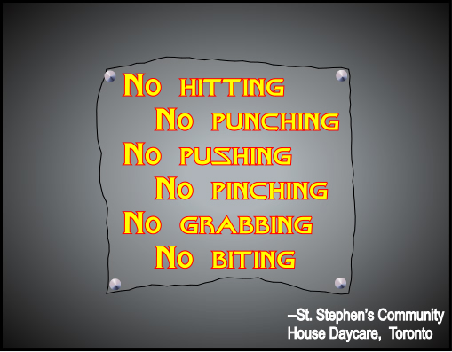
Notes:
3
3
Organization/Exercise Structure:
Discuss room layout and function.
Identify that this is a facilitated tabletop exercise. That means that most of the discussion will be driven by the facilitator posing questions. The discussion should be driven by the identified scenario and established plans, policies and procedures. The format allows for free discussion to allow you, as players, to take necessary steps to respond to the scenario.
Audience/Participants: Facilitator, evaluator, identify all of the groups present, identify any observes or media if present.
This will be a facilitated tabletop exercise. Players will participate in the following modules:
Module 1A: Pre-Incident Notification (Watch)
Module 1B: Pre-Incident Notification (Warning)
Module 2: Response
Each module begins with an update that summarizes the key events occurring within that time period. Following the updates, participants review the situation and engage in discussions of appropriate preparedness and response activities.
Assumptions
Scenario could actually occur but is not the objective of the exercise, just the conduit for the Full Scale Exercise
Events occur as they are presented
There are no “hidden agendas”
Exercise Rules
There are no right or wrong answers; some discussion points may be uncomfortable, but bring them forward. This is an exercise and this is where we learn. It is not real…at least not yet. We want to learn about our strengths and weaknesses now…not during the actual emergency. Your input can help others to realize something that has not been thought about before. Just because we may have processes in place, doesn’t make them a good or the best process. Use the opportunity today to actively explore activities/options/decisions related to the presented scenario. Your best response should be based on the circumstances presented
Not limited by organizational positions/policies
Decisions are needed for the Full Scale Exercise
Decisions are not precedent setting
May not reflect organization's/individual’s final position
Cooperate
Presented information will serve as the basis for discussion
Facilitator has the right to table discussions for exercise flow…
TIPS: Tips for Participants
Treat scenario information as real events
Participate openly
Ask questions
Share your thoughts
Work towards decisions to address the evolving scenario
This is an open, low-stress, no-fault environment. Varying viewpoints, even disagreements, are expected.
Respond based on your knowledge of current plans and capabilities (i.e., you may use only existing assets) and insights derived from training.
Decisions are not precedent setting and may not reflect your final position on a given issue. This is an opportunity to discuss and present multiple options and possible solutions.
Issue identification is not as valuable as suggestions and recommended actions that could improve mitigation, planning, preparedness, response and recovery efforts. Problem-solving efforts should be the focus.

Slide 4
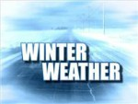
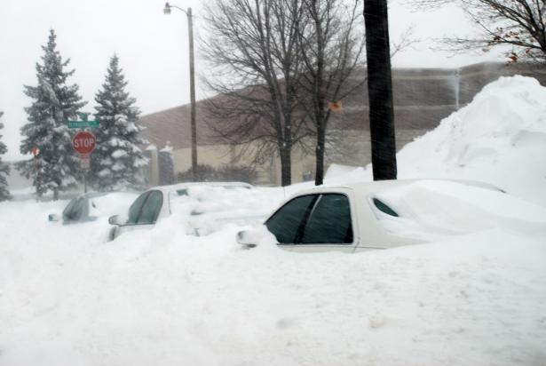
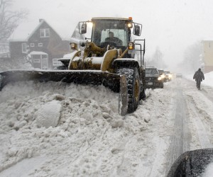
Notes:
Of the many potential disasters faced today, natural disasters are still among the highest risk for Minnesota. The Mayo Clinic Hazard Vulnerability Assessment identifies severe winter weather as the highest vulnerability to the Hospice Program operations. Freezing rain is common in Minnesota, generally occurring at the narrow boundary between cold air from the East and North and moist air from the South. Typically, a warm air mass will come up along the Mississippi Valley and overrun a shallow layer of cold air trapped at the surface.
Snow is produced at upper level in such a winter storm system but it eventually melts into rain in the warm layer, above freezing temperature, associated with the overrunning. When that rain touches the ground in the cold air below the droplets freeze on contact, which generally results in small accumulations of ice. If the cold air layer is too thick, the droplets refreeze before hitting the ground and form sleet or ice pellets which are less hazardous.
Minnesota typically receives freezing rain numerous times throughout a winter season. However, it usually lasts only a few hours and leaves little accumulation. It renders roads and sidewalks slippery, causing minor traffic collisions, but road crews use de-icing material to take care of it. Power lines and other equipment are built according to tough standards since large accumulation events have happened in the past.
4

Slide 5
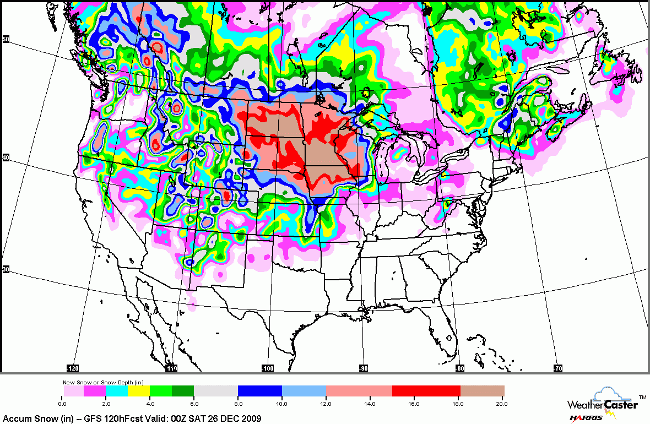
Module 1 Scenario
Notes:
December 8, 2011, 1700: National Weather Service, La Crosse Station has issued a Winter Storm Watch for its entire service area. The slow moving storm system has resulted in over 18 inches of snow accumulation across southern North Dakota and over two feet of snow across northeastern South Dakota in recent days. Beginning the evening of December 10, 2011, heavy snowfall is expected in Southwest Minnesota and Northwest Iowa. By early morning December 11, the snow system is expected to hit Southeast Minnesota, Northeast Iowa and Western Wisconsin. Snow accumulation is expected to surpass two feet.
5

Slide 6
Discussion
Notes:
6

Slide 7
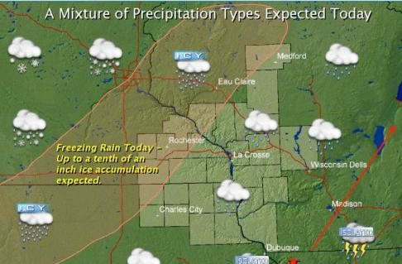
Freezing rain today – up to six inches of ice accumulation expected
Notes:
December 10, National Weather Service has issued a Winter Storm Warning.
7

Slide 8
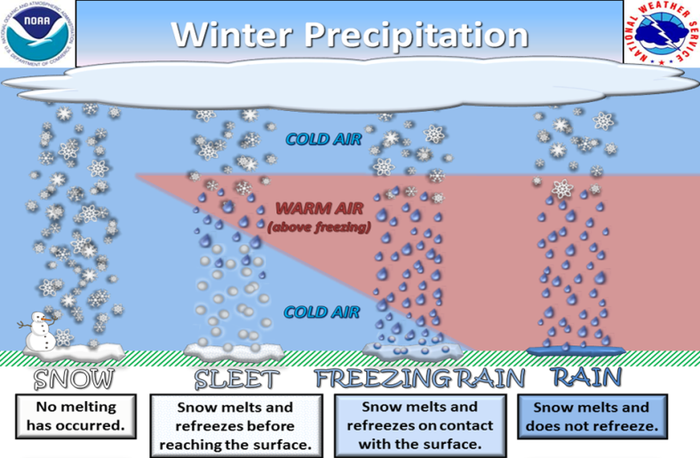
Module 2 Scenario
Notes:
8
December 11
The Perfect Winter Ice Storm
On December 10, 2011 an upper level low system stalled over the Midwest pumping warm and moist air from the Gulf of Mexico toward the plains. The upper flow, then turning eastward, was bringing this air mass down over Minnesota. At the same time, a high pressure centre was sitting further north in Manitoba and Ontario, keeping an easterly flow of very cold air near the surface. For winter, an unusually strong Bermuda high pressure area was anchored over the Atlantic Ocean, which prevented these systems from moving further to the east, as most winter storms do when they pass through the Midwest.
A series of surface low pressure past in this circulation between December 11 and December 17, 2007. For more than 72 hours, steady freezing rain and drizzle fell over an area of several thousand square miles of Northern Iowa, Southeastern Minnesota and Southwestern Wisconsin.

Slide 9
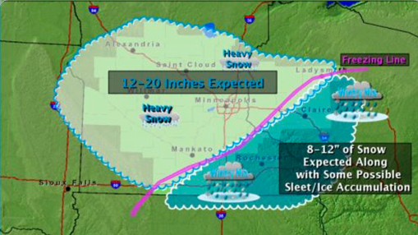
Module 2 Scenario
18-26 Inches of Snow
12-18
Inches of Ice
Notes:
Result…
9

Slide 10
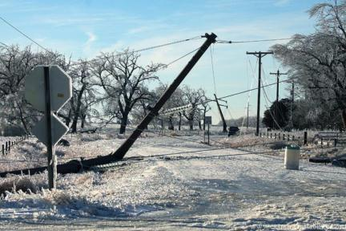
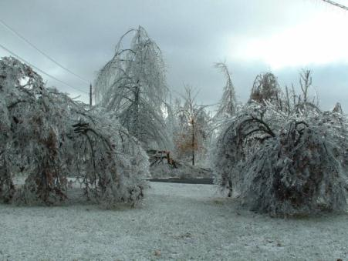
Module 2 Scenario
Notes:
10
December 14: Many power lines broke and over 1,000 pylons collapsed in chain reactions under the weight of the ice, leaving more than 4 million people without electricity, most of them in central and southeastern Minnesota and Southwestern Wisconsin. At least twenty-five people died in the areas affected by the ice, primarily from hypothermia, according to the Rochester Post. Twelve more deaths and hundreds of millions of dollars in additional damage were caused by the flooding farther south from the same storm system.
All bridges throughout central and southeastern Minnesota and southwestern Wisconsin are closed because of concerns about weight tolerances or ice chunks falling from the superstructures. All power linkages to the southeastern Minnesota and southwestern Wisconsin communities are down and are not expected to be operational for several days. Loss of power has disabled all of the city's water pumping stations and water treatment plant.
Thousands of trees were brought down by the weight of ice around the affected areas. As many trees were damaged or fell by the heavy ice.
Critically, about 1,000 steel electrical pylons and 25,000 wooden utility poles were brought down throughout Michigan, further damaging power supply and hampering the return of electricity. Utility crews are already at work to begin repairing the damage.
With the roads blocked by fallen trees, broken power lines and coated with a heavy layer of ice, emergency vehicles can hardly move. Transportation throughout the impacted area is shut down.
Farther to the south, central Iowa, received heavy rain and severe flooding, while further north, central Minnesota and Northern Wisconsin mostly received heavy snow. Exacerbating the problem was a steep drop in temperature that immediately followed the passage of the freezing rain, which combined with the extreme power outages led to numerous indirect deaths due to carbon monoxide poisoning from generators and other sources as people desperately tried to remain warm.

Slide 11
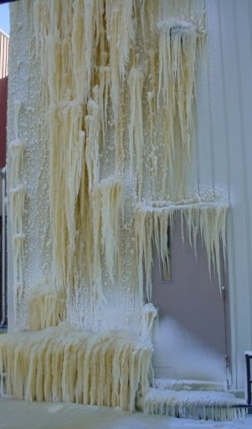
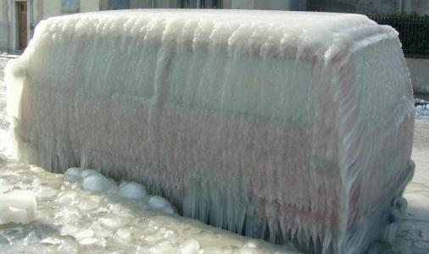
Module 2 Scenario
Notes:
11
The van reflects what all vehicles on the hospital grounds look like.
The picture on the right reflects what all exterior facilities look like.
Inches of ice coat all exterior surfaces!

Slide 12
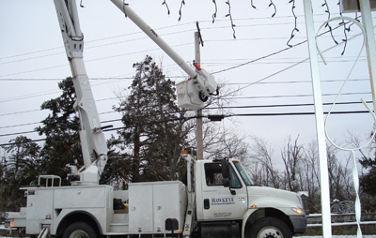
Module 2 Scenario
Notes:
12
Impacted counties and cities have declared a state of emergency. The Governor has declared a state of emergency for affected areas and has submitted a request for a Presidential disaster declaration. The Presidential decision is pending. Local emergency response is focused on returning electricity to the community, opening transportation routes, and providing services to special needs population groups.
December 14
Community Response
State of Emergency
Electricity
Transportation
Special Needs Populations

Slide 13
Discussion
Notes:
13

Slide 14

Notes:
Player Debrief/Wrap Up
Complete Notes
Take with you
Participant Feedback Forms
Email/Survey
Player Comments
Good, Bad, or Ugly
14

Slide 15

Notes:
15
Participants
Exercise Planning Team

