Slide 1
Cannon Falls Evacuation Outcome
Chosen Valley Care Center, Inc.

Slide 2
Welcome and Introduction
Chosen Valley Care Center
Carrie Colbenson-Director of Nursing
Melissa Fenske-Director of Social Services
Gerry Gathje-Director of Environmental Services
Susan Neis- Emergency Preparedness Coordinator/Human Resources Assistant
Communication during an evacuation

Slide 3
Communication
Cannon Falls was an amazing learning experience
This evacuation process showed us our own strength and weaknesses and let us build on it
This situation could happen to any of us
How would we have been any different?
Here today to talk about what has come from this experience to better improve our own EOP
New policies, procedures and a huge impact on our Communication Process during an Emergency
We will talk about some negatives and positives that happened, and then at the end what processes came from it all.

Slide 4
Positives
The evacuation process showed us how our facility will react during a high stressful situation and it was a positive light
The management team worked hard in getting care plans out for the receiving residents and making sure meals were ready in the right density and rooms were ready as well
Our staff welcomed the Cannon Falls residents with Open Arms and did not show any signs of stress with the extra guests
It was a great thing to see during a time of need that our staff was so resilient and wanting to be comforting to them
We learned more information then we knew would be a process for our EOP
It showed us our own strength and weaknesses, and we have been able to build on that aspect

Slide 5
Negative
This entire situation was a challenge for all entities involved and we have all taken a lot with us after the process. We have learned so much from this experience and that it has helped us become stronger as a facility. Some things that were effected:
Knowing male/female for receiving residents and knowing if we would have the beds
A fellow staff member for a friendly face
Access to residents information, MAR, TAR, DNR, Allergies, Care Plans Etc.
Proper medication for residents
Clothing and items marked with identification
Uncertain of our position as the receiving facility-do we do MDS’s, are they our residents?

Slide 6
Receiving Residents
From the outcome of the Cannon Falls Evacuation, we have put together some polices for our EOP, including a receiving residents policy.

Slide 7
Receiving Plan
Chosen Valley Care Center, Inc. Resident Receiving Policy Sample
It is the policy of Chosen Valley Care Center to always remember that our first and foremost priority is to our residents.
First Steps:
When we are requested to receive residents from another facility due to Emergency Conditions, there are certain regulations and information that need to be maintained before we can start the process.
When called by Mayo Clinic and/or from another facility requesting that we take on extra residents due to an Emergency Evacuation, it is necessary to get the following information immediately, and to take these proper steps:
Director of Nursing and Director of Clinical and Residential Services and Director of Social Services should be contacted immediately if they are not in the facility. (Administrator will be contacted by DON/DCRS)
DON and DCRS in return will contact the facility requesting and/or contact Mayo Clinic’s admission/transfer center, and their contact number is 507-293-4961
Contact Public Health in Fillmore County for communication purposes and assisted help and information
Contact Emergency Management at Mayo Clinic to share information and receive information
Contact Program Administrator as they are in charge of the Emergency Evacuation contact person for the financial piece and he will get the information to the sending facility
Contact the Ombudsman, Director of Social Services would contact about evacuees
Receiving Facility Responsibilities:
If our facility will be accepting relocated residents/patients and will exceed licensed capacity, we should contact the MDH Health Regulation Division. Temporary waivers may be granted in an emergency
The receiving facility should maintain a log of residents/patients relocated to our facility (attached)
If the evacuated residents desire to remain at the receiving facility rather than going back to the original facility, it is within their rights to do so. The receiving facility is under no obligation to return the patient/resident to the evacuating facility if the resident, guardian, or POA determines they would like to remain at the receiving facility
Communication:
Once the proper facility/Mayo Clinic is contacted it is in the best interest for both facilities that the communication is vital, information that needs to be shared immediately to fulfill the request is as follows:
DON from requesting facility phone number and who to contact if he/she cannot be reached
How many residents and if they are female/male.
The time frame of when resident’s would be arriving so that all staff would be notified
Nurse to Nurse report
How Residents will be transferred to our facility
If/When staff from other facility would or would not be accompanying residents
If able to access Point Click Care from receiving facility, get remote access from DON at that facility to be able to access all information on receiving residents
If unable to get access to PCC, then Information such as Family Contact numbers, Medications, Care Plan, skilled stay, personal item list should be either communicated to DON/DCRS and/or faxed to our facility within 1-2 hours before residents will be arriving. If requesting facility does not have electricity it should be communicated via phone call or personal email from requesting facility to our facility
Talk with Therapy department about residents who may be a skilled stay and/or have therapy needs, and how they can help during their stay at our facility
Arrival:
When the residents arrive at our facility it is important to remember that this could be a traumatizing experience for them and that we are to keep this process as simple as we can for them and as welcoming, the following are things that should be done as soon as their arrival:
Director of Social Services/Social Services Designee should be contacted by DON/DCRS and at our facility if possible for a smooth transition
Gather each resident into the same room so that they have a familiar face
Talk with the residents to let them discuss what happened and how they are feeling
Have soft music for them, snacks, drinks etc. so that they will feel welcome in our facility
Ensure that staffing is aware of the arrival and so they can meet some of the staff to help them feel more comfortable about their time at our facility
Help them with their personal belongings and reassure them that we will take care of not only them but their items
Show them their room, if possible have them in the same hallway and/or let them know where other residents will be located to help them feel safe
If possible, let the residents coming from the facility sit at the same table during meals so that they can feel good about this temporary move
Reimbursement:
For payment and MDS purposes the receiving facility is accepting the resident temporarily. The receiving facility is not required to perform the usual admission procedures nor do they need to prepare the MDS assessment, case mix assessment and care plan. This applies for the first 30 days of the disaster. During this period, an assessment should be made as to the future viability of the evacuating facility. If it is determined that the evacuating facility will NOT be able to resume services, further instructions will be provided by Mayo Clinic and/or from the receiving facility.
The evacuating facility will continue to bill for their services as if the residents were there for the entire month (excluding hospital admissions and/or death). The evacuated facility will be responsible for reimbursing’s the sheltering facilities by submitting the Facility Evacuation Form to the MN Department of Human Services (DHS).
The sheltering facilities will be reimbursed at the statewide average daily rate per day by DHS. This payment will go to the evacuated facility as a lump sum after residents are back the evacuating facility. The evacuating facility is responsible for paying the sheltering facilities.
If a sheltering facility receives a high acuity patient whose care costs more than the statewide average daily rate, DHS will review the difference. These extra costs can be submitted to the evacuating facility for consideration by DHS.
DHS will only reimburse the evacuating facility for expenses that are not covered by other sources (e.g. insurance) and if payments are received from other sources after DHS makes payment, DHS will expect those costs to be returned to DHS up to the amount received from other sources.
Emergency Contact List:
Healthcare Multi-Agency Coordination Center: 651-201-4101
Fillmore Public Health: 507-765-3898
Mayo Clinic Emergency Preparedness Contact: 507-266-2969
Program Administrator/Nursing Facility Rates & Policy: 651-431-2271
Mayo Clinic Admission/Transfer Center: 507-293-4961
Duty Officer: 1-254-543-6490
Ombudsman: 651-431-2555 or toll-free 1-800-657-3591

Slide 8
Point Click Care
Utilizing our own charting system to benefit a receiving facility

Slide 9
Point Click Care
The benefits for utilizing our own charting system are as follows
Fast access to all documentation that is needed for residents
MAR, TAR, Allergies, DNR, contact list, Care plan
Even if you do not use PCC, you can utilize our PCC and we will still be utilizing HIPAA rules and regulations
Set up is done in minutes and can sign in immediately
Everything can be printed off for charting purposes
We have a Power Point Presentation on how to set up this function if needed by any other facilities.

Slide 10
Facility Calling Tree
During our After Action Report it was brought up that we should utilize a calling tree system in our facility for maximum communication to the management and all employees.

Slide 11
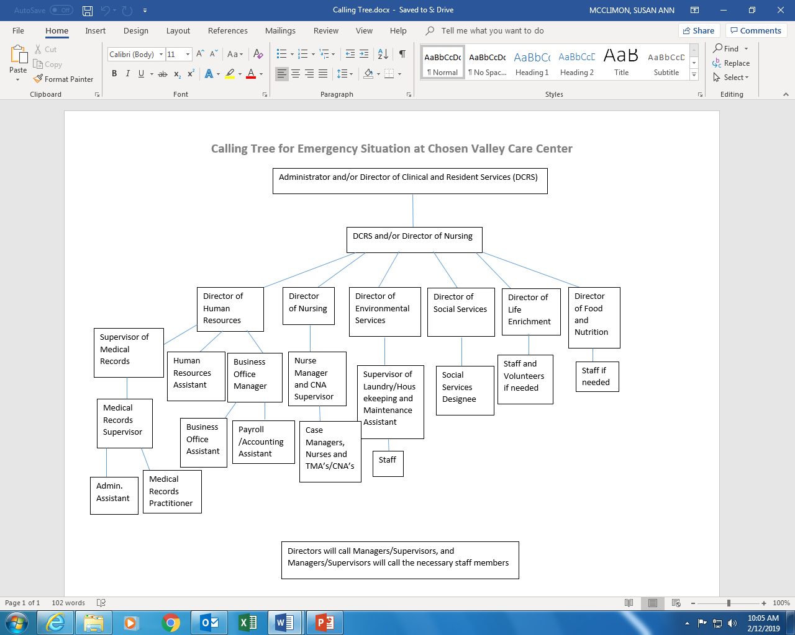

Slide 12
Emergency Hotline
In our EOP we have set up a policy based on our Hotline that will be activated during an emergency to let families know where to contact us

Slide 13
Emergency Hotline
Set up an emergency message on our phone system that when we push a button the emergency message will be activated
When family and staff call our main number they will be directed to the Emergency message and then will be given a number to call for more information
This emergency message can also be activated from our outside phone company in the case that we can not access the main desk area during an emergency
Our hotline number/message helps us relay a message to all that are concerned to let them know that we are doing all that we can and a number to reach during an emergency event. This hotline ensures family members that we will be in contact with them ASAP.

Slide 14
Summary
Thank you for your time today, there are quite a few more policies that we have come up with, but these 4 that have been implemented have a good impact on our residents safety and the efficiency for our facility during an emergency.
Any Questions?!

