Slide 1
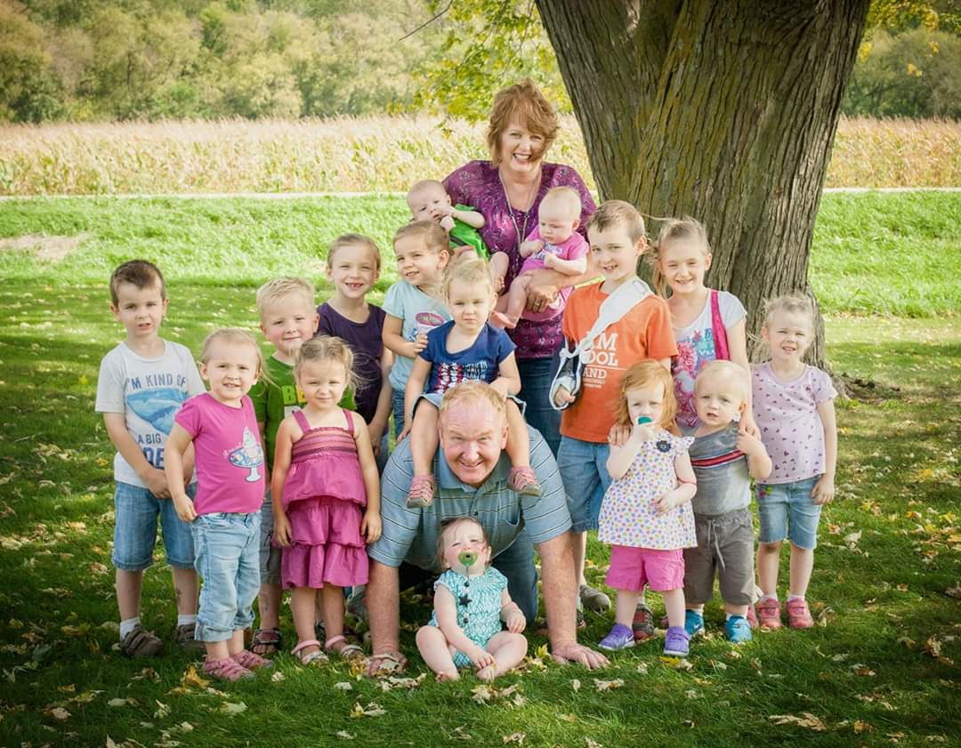

Slide 4
Emergency Preparedness training
ACTIVE SHOOTER AND EVACUATION SIMULATIONS

Slide 5
Getting STARTED
CONTACTED FILLMORE COUNTY SHERIFF JOHN DEGEORGE AND ALICE TRAINERS JESSE BETTS AND TIM RASMUSSEN
HAD MANY CONVERSTAIONS ON HOW TO SET UP TRAINING AT OUR FACILITY
DIFFICULT DUE TO BEING A CARE CENTER AND NOT A SCHOOL
ONCE ALICE TRAINERS WERE ON BOARD:
CONTACTED CHATFIELD PD AND CHATFIELD AMBULANCE
HAD A MEETING WITH ALL THREE DEPARTMENTS

Slide 6
challenges
Being a long-term care facility it is difficult to do a simulation with an active shooter due to vulnerable adults
Having to do our own simulation with the Chatfield pd and ems without the a.l.i.c.e trainers
Not only challenges for our facility but asking the local emergency agencies to also help out

Slide 7
Our ‘active shooter’

Slide 8
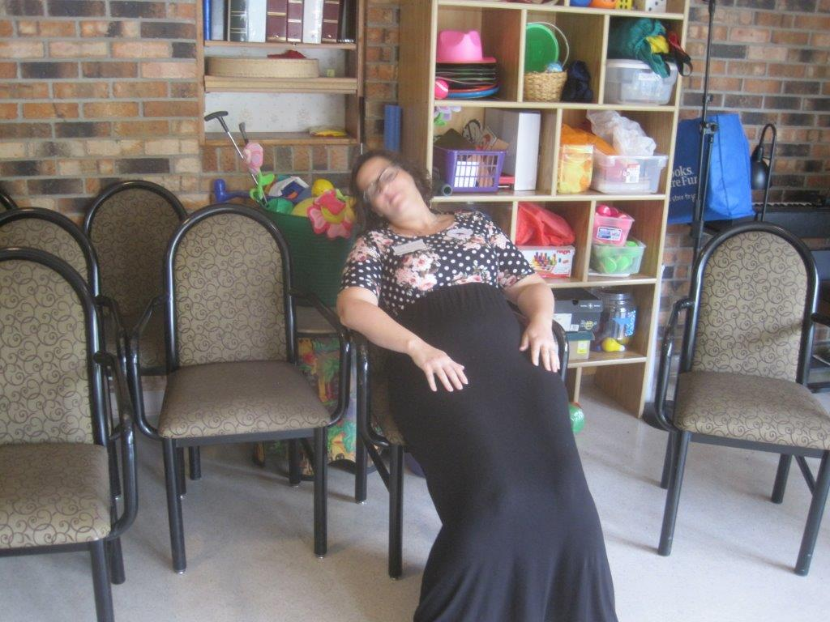
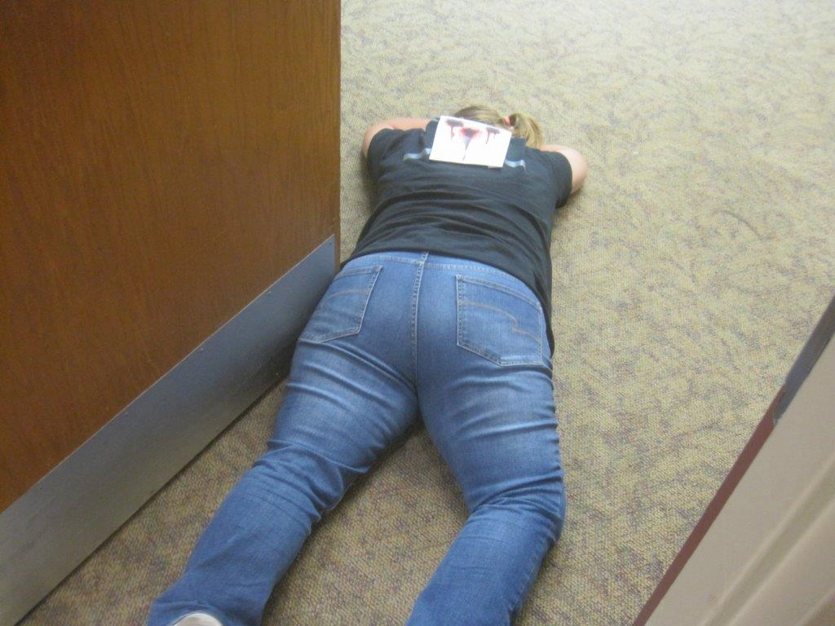
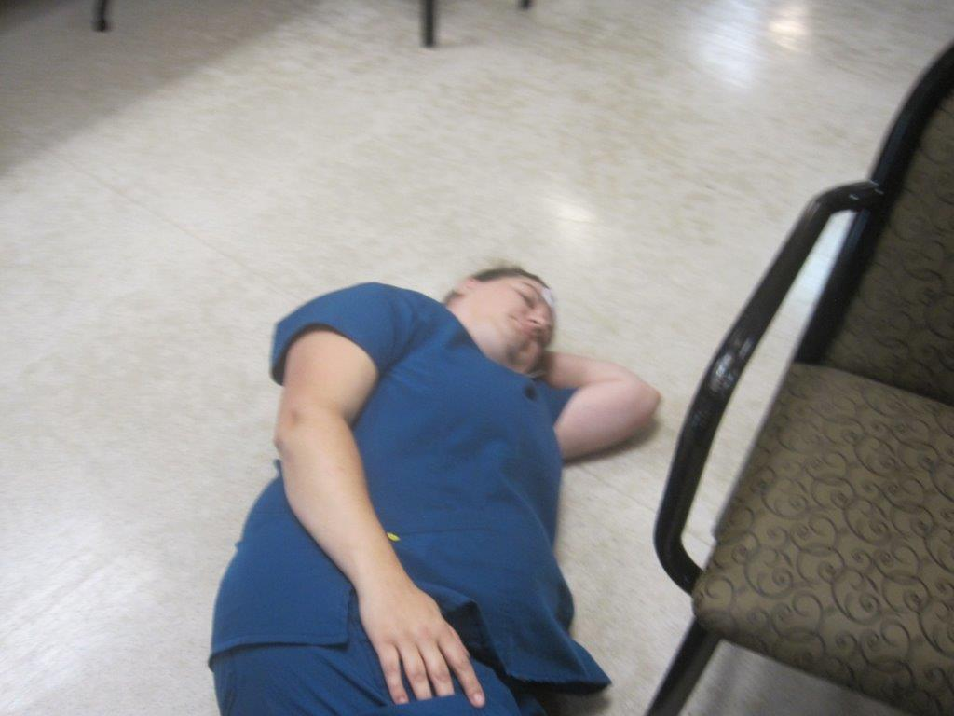
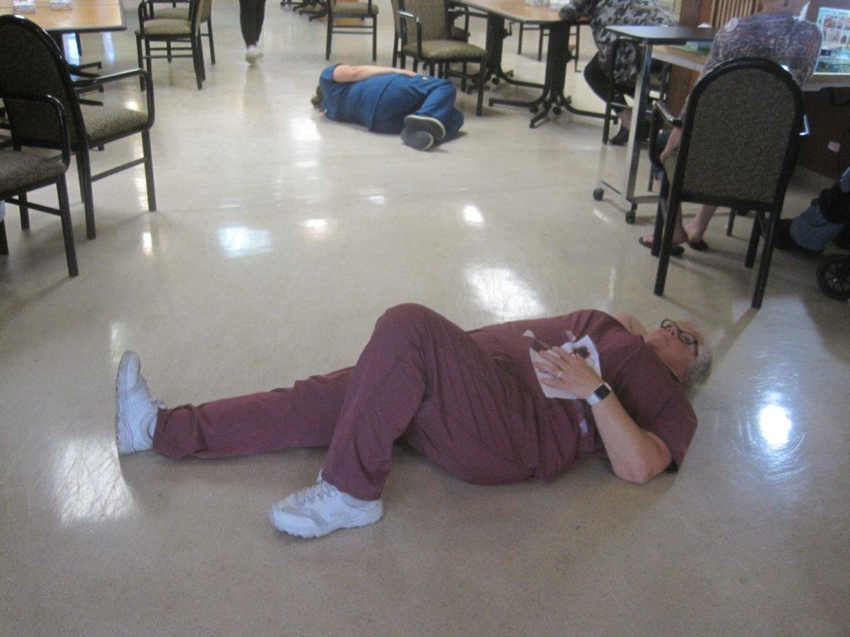
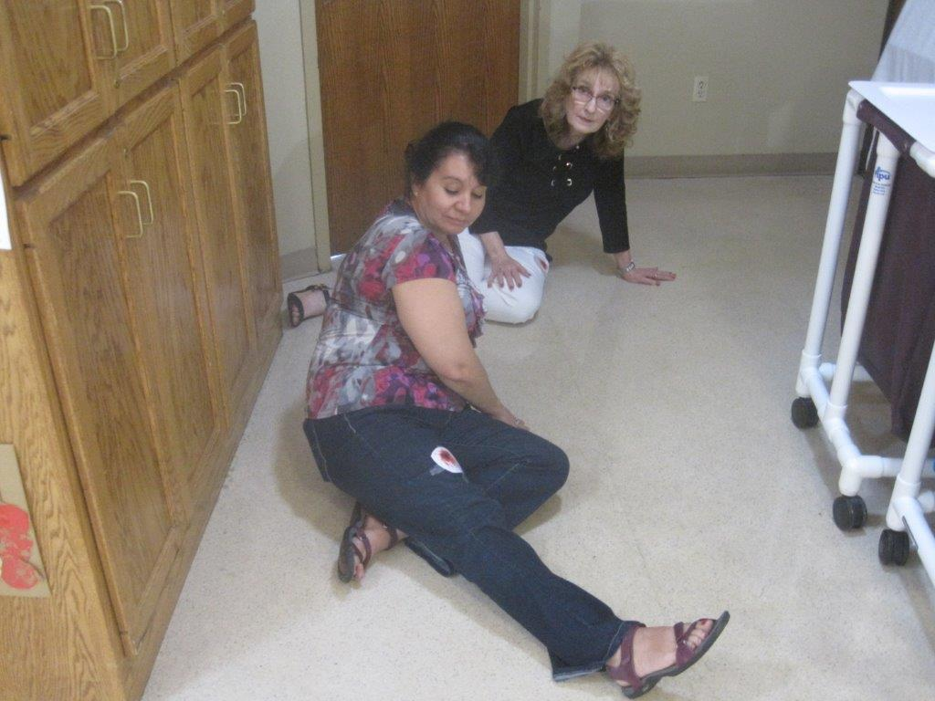
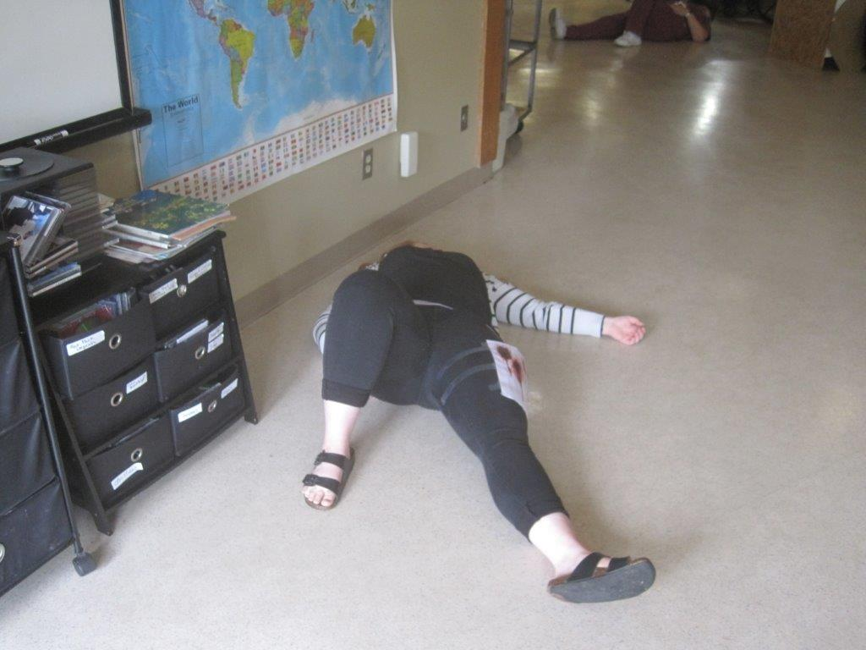
Injured/Fatal

Slide 9
Overcoming challenges
Many discussions on where to have the simulation took place
Needing to continue resident activities as to not interfere with their daily lives
Needing to ensure that residents are not scared during simulation
Had training in our big activity room, while church was right next door
Blocked off the big activity room and the dining room during the simulation
Keeping doors closed so residents would not walk in in on an ‘active shooter’ simulation

Slide 10
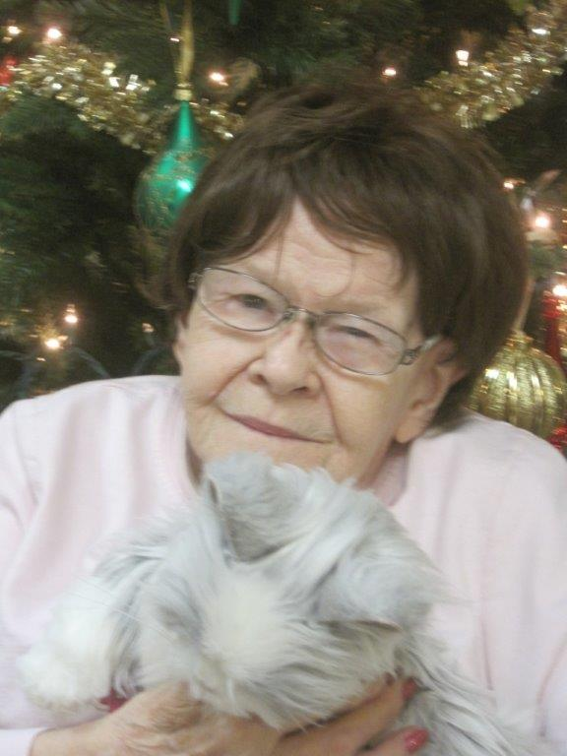
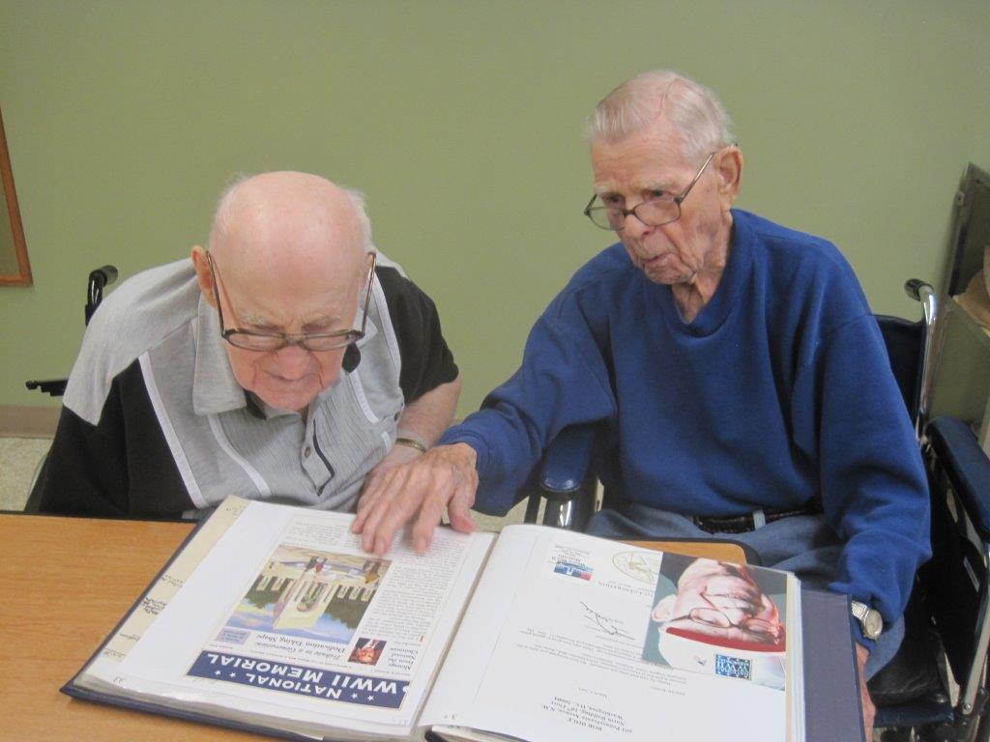
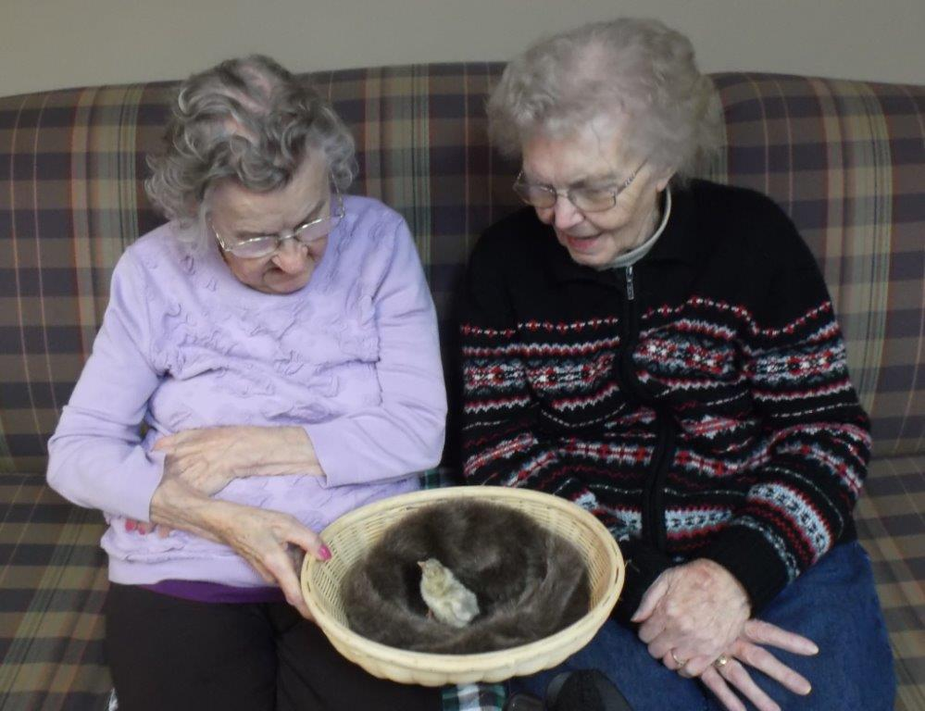

Slide 11
a.l.i.c.e training
At 1 pm our a.l.i.c.e trainers showed at our facility to give a crash course training based on a long-term care facility, since they have not done the training at other facilities.
ALERT
LOCKDOWN
INFORM
COUNTER
EVACUATE

Slide 12
Active shooter training video
ALL OF OUR OWN STAFF FOR ACTIVE SHOOTER, INJURED AND VIDEO
ALL EMPLOYEES WERE USED AND WENT THROUGH SPECIFIC STEPS TO ENSURE SAFETY OF SELF AND OTHERS

Slide 13
Incident command system

Slide 15
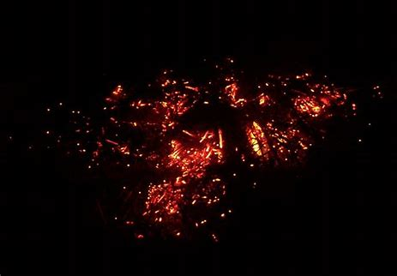

Slide 16
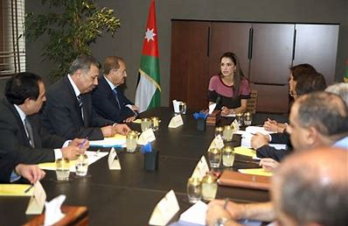

Slide 17
Getting the ics team ready
Not only did we have to have our plans for the simulation ready, but we wanted to ensure that our ics team was prepared and ready to take action!

Slide 18
Ics breakdown
Once our facility was given the all clear from Chatfield pd the ics team met at the center core which is our communication base
Playing out our report to the ics team
The ics team decided due to circumstances that they were going to have to evacuate a portion of the facility
What action steps need to be taken to ensure the safety of your life and the life of others

Slide 19
From ‘active shooter’ to evacuation

Slide 20
Evacuation challenges
For our policy we have a staging area where our residents go to get their wrist bands and their items before being transported, there was some challenges based on the staging and getting everyone where they needed to be after they were given the ‘all clear’ from the active shooter

Slide 21
Media report video
Melissa FENSKE
PUBLIC INFORMATION OFFICER
PRE WRITTEN TEMPLATE FOR ALL EMERGENCIES

Slide 22
A.L.I.C.E Training- ‘Active Shooter’ Simulation and Evacuation Drill
9/11/2019
After-Action Report / Improvement Plan 2019
Date Published: September 23rd,2019
Chosen Valley
Care Center, Inc.

Slide 23
AFTER ACTION REPORT
Exercise or Incident Name | A.L.I.C.E Training- ‘Active Shooter’ Simulation and Evacuation
Exercise or Incident Dates | September 11th, 2019
Scope | This exercise/incident was a planned exercise event at Chosen Valley Care Center, Inc on September 11th,2019 at 1:00 pm. This exercise response evaluation was a community-based exercise between Chosen Valley Care Center, Inc. Emergency Preparedness Committee/Incident Command System, Fillmore County A.L.I.C.E Trainers, Chatfield Police Department and Chatfield EMS.
Mission Area(s) | Response
Capabilities | To work on our Emergency Operations Plan and policies for ‘Active Shooter’ and our evacuation steps and policies.
Objectives | Test the policies and procedures. Training for staff and ICS during an emergency. Communication during an emergency between facility and staff and between facility and Local Emergency Agencies. Local Emergency Agencies to help with policies and procedures for our facility.
Threat or Hazard | ‘Active Shooter’ and then due to a bullet going through an electrical panel, was necessary to evacuate our A wing residents to the Calvary Baptist Church.
Scenario or Incident Description | A disgruntled employee entered the back large Activity room and started a mass casualty episode. The Chatfield Police Department apprehended the ‘Active Shooter’. The facility was then accessed and realized that due to a bullet going through an electrical panel, it was necessary to evacuate our A wing residents to the Calvary Baptist Church.
Participating Organizations | Attached in Appendix B.
Point of Contact | Susan Neis- Emergency Preparedness Coordinator

Slide 24
Thank you for listening!
Any questions?
Comments?
Concerns?

